Slide 2
Background
Existing voluntary training program from 2009
CA stores have 1000 employees, out of which more than half have already opted for the training program
Planning to implement the mandatory training program with 3 steps:
Completion of training for untrained employees
Training to be included in the orientation program for new hires
To be expanded over all product categories
Estimated cost of the implementation = $14 M

Slide 3
Research Question
Will training modules help improve the selling skills of salespeople?
If so, how much?

Slide 4
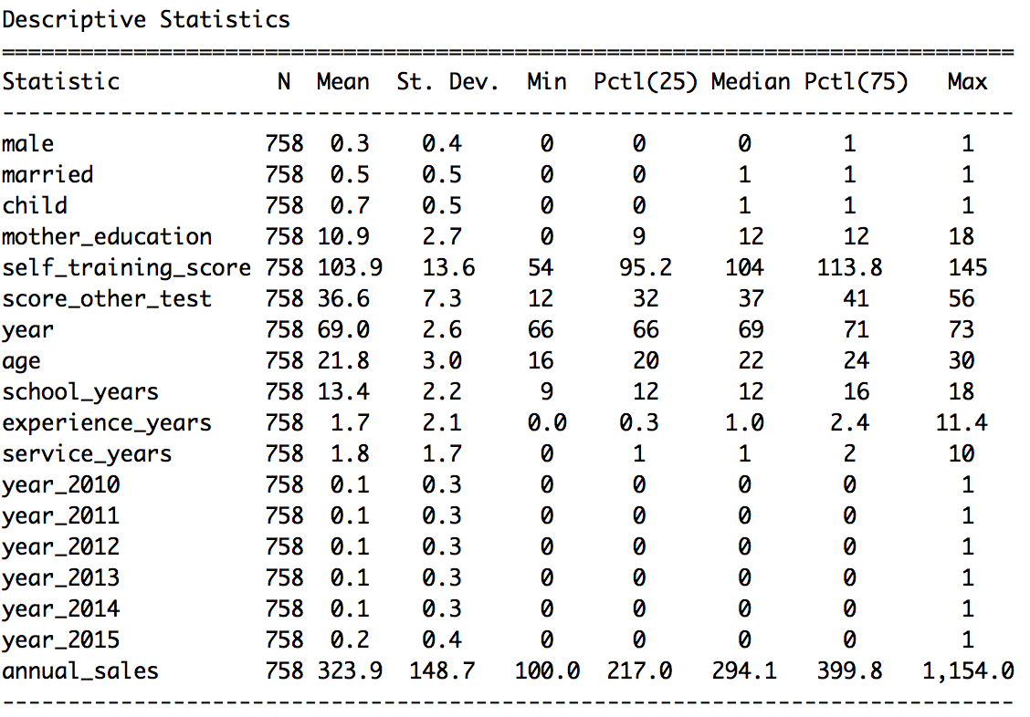
Summary Statistics

Slide 5
Variables to Consider
Dependent Variable: Annual_sales
Key Independent variable: Self_training_score
Control variables:
Experience years
Service years
Gender
Age
Marital status
Child
School years

Slide 6
Analysis of variables
Omitted variable bias : Bias in self training score owing to motivation
Endogeneity in self training score
Omitted variable bias
Selection bias
Instrument variables:
Score other test
Mother’s education
There is no multicollinearity between the independent variables

Slide 7
Theoretical Model
Stage 1:
Self_training_score* = γ₀ + γ₁score_other_test + γ₂mother_education + γ₃year+ γ₄logexperience + γ₇age + γ₈child + γ₉male + γ₁₀service_years + γ₁₁married + γ₁₂school_years
Stage 2
logannualsales = β₀ + β₁Self_training_score* + β₂year+ β₃logexperience + β₄age + β₅child + β₆male + β₇service_years + β₈married + β₉school_years

Slide 8
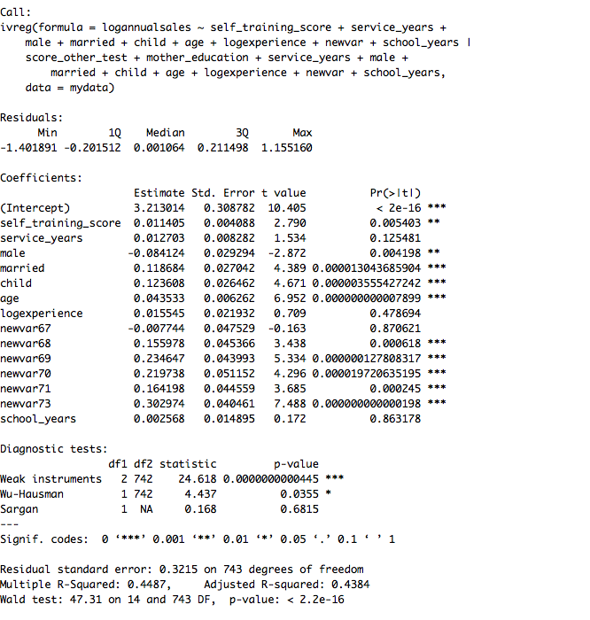
Model Diagnostics
The instruments are correlated with key independent variable (relevance assumption) but not with the dependent variable (exogeneity assumption)
The Hausman test indicates that 2SLS model resulted in less biased coefficients

Slide 9
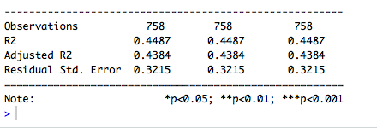
The model exhibited heteroskedasticity which was rectified for clustered robust standard errors

Slide 10
Comparison between trained and untrained employees
 | Trained Employees | Untrained Employees
Predicted Sales per employee($)* | 295,964 | 282,054
Difference between the sales of two groups per employee= $13910
Impact of training on the untrained group of employees as per the predicted sales = 13910*242 = $3,366,278
= $3.36 million
* The predicted sales were calculated using average self training score for the trained and the untrained groups

Slide 11
Interpretation of Results
1 point increase in the self training score increases the sales by 1.14 %

Slide 12
Interpretation of Results
Implementation Steps | Interpretation
Completion of training for untrained employees | Increase in sales by $ 3.36 million
Training to be included in the orientation program for new hires | More data required on the number of new hires
To be expanded over all product categories | Information on existing product categories is required and their impact on training needs to be analyzed

Slide 13
Implication on business
The data contains information on the annual sales of the employees for the year in which they completed the training.
The increase of 3.36 million dollars is for the current year
Implementation of the entire training program will require more information and analysis
Without further information, it will be a risky investment

Slide 14
Conclusion and Suggestions
Not to be implemented without further information
Gathering data including
No of new hires
Existing product categories
Attrition rate
Qualification
Sales performance over the years

Slide 15
Questions?

Slide 16
Thank You

Slide 17
Appendix

Slide 18
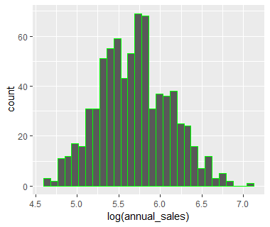
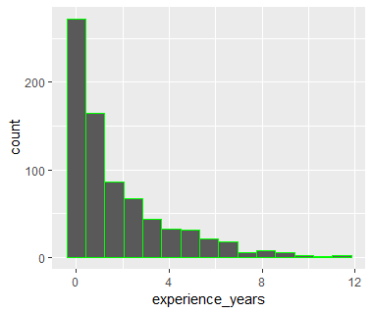
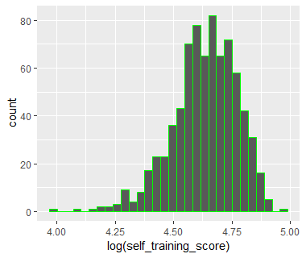
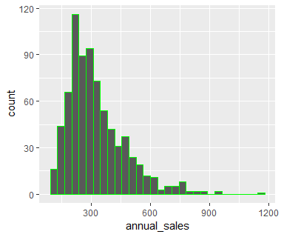
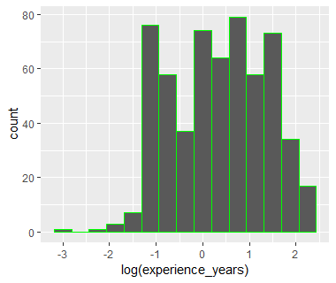
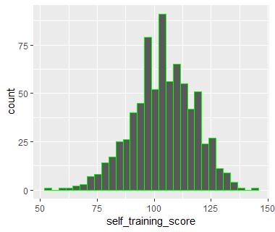

Slide 19
Why Not OLS Estimator:
Violation of Classical Assumption III:
Omitted variables Bias:
Motivation
Incentive/commission program
Violation of Classical Assumption IV:
Heteroskedasticity in the data

Slide 20
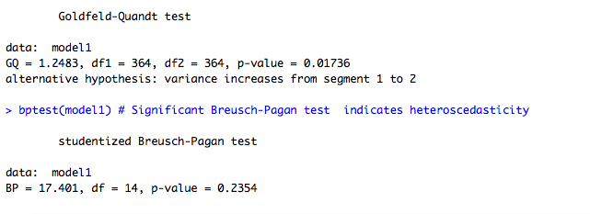
Heteroskedasticity test
Residual Plot

Slide 21
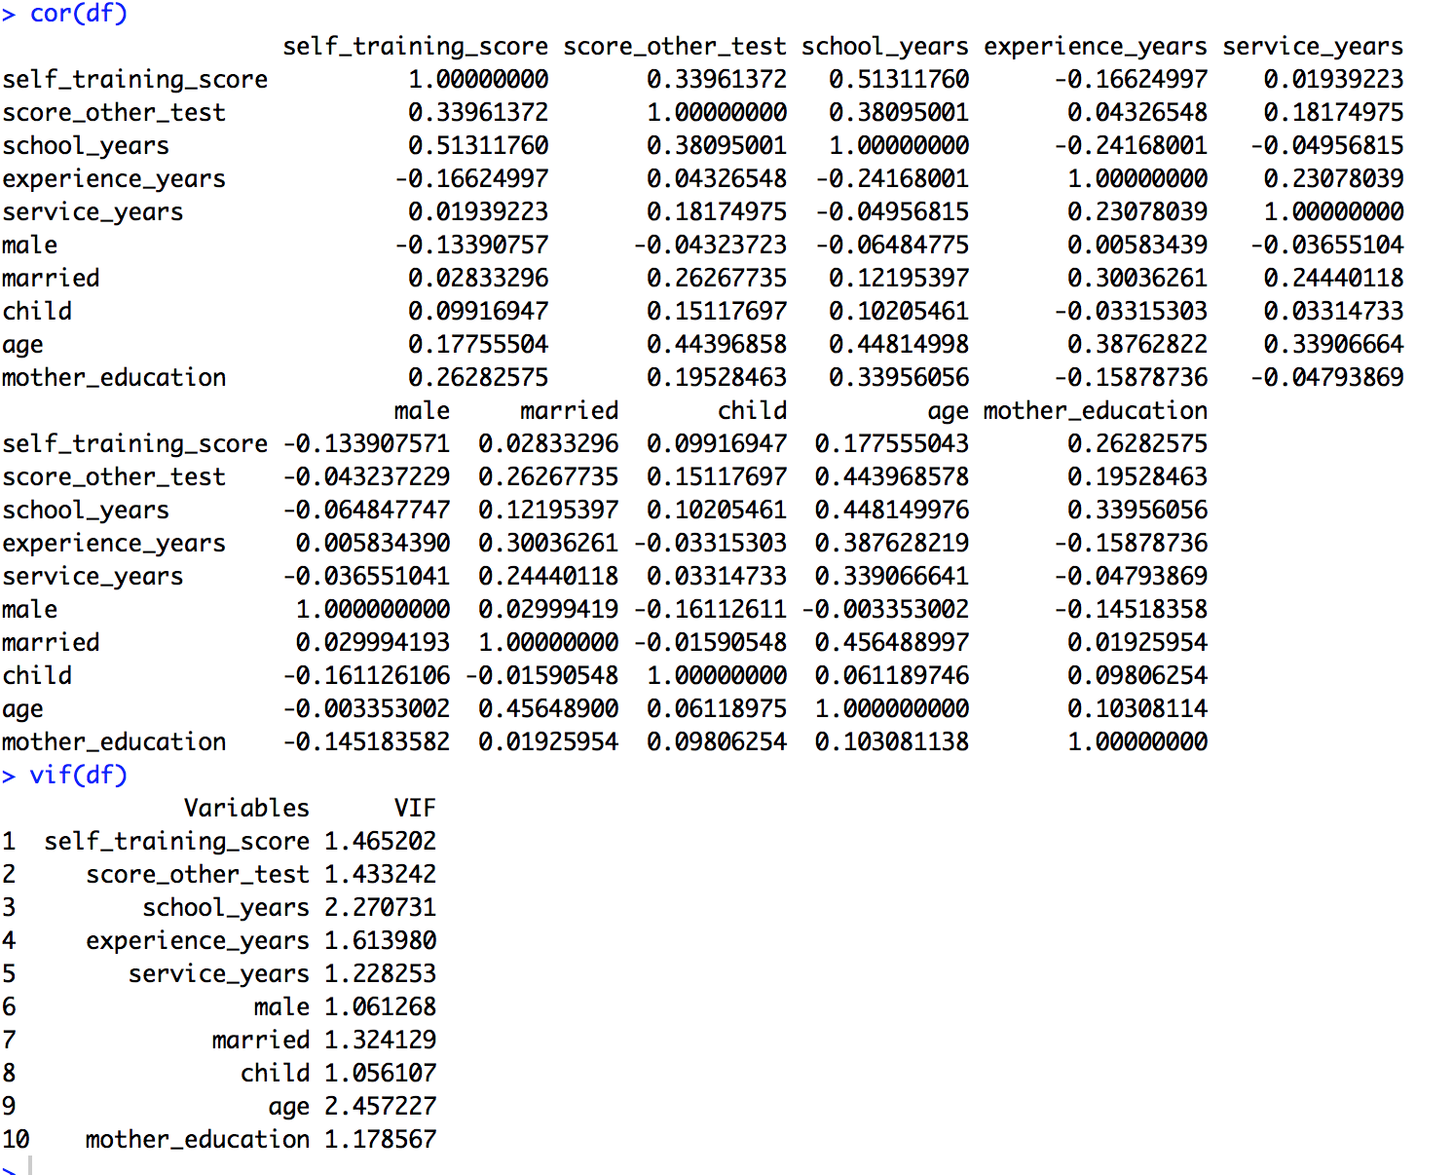
Multicollinearity test
There is no multi-collinearity between the independent variables

Slide 22
Model Statistics

